Slide 1

ASL INTERPRETING
GLOVE
Midterm
Presentation
Team 7

Slide 2
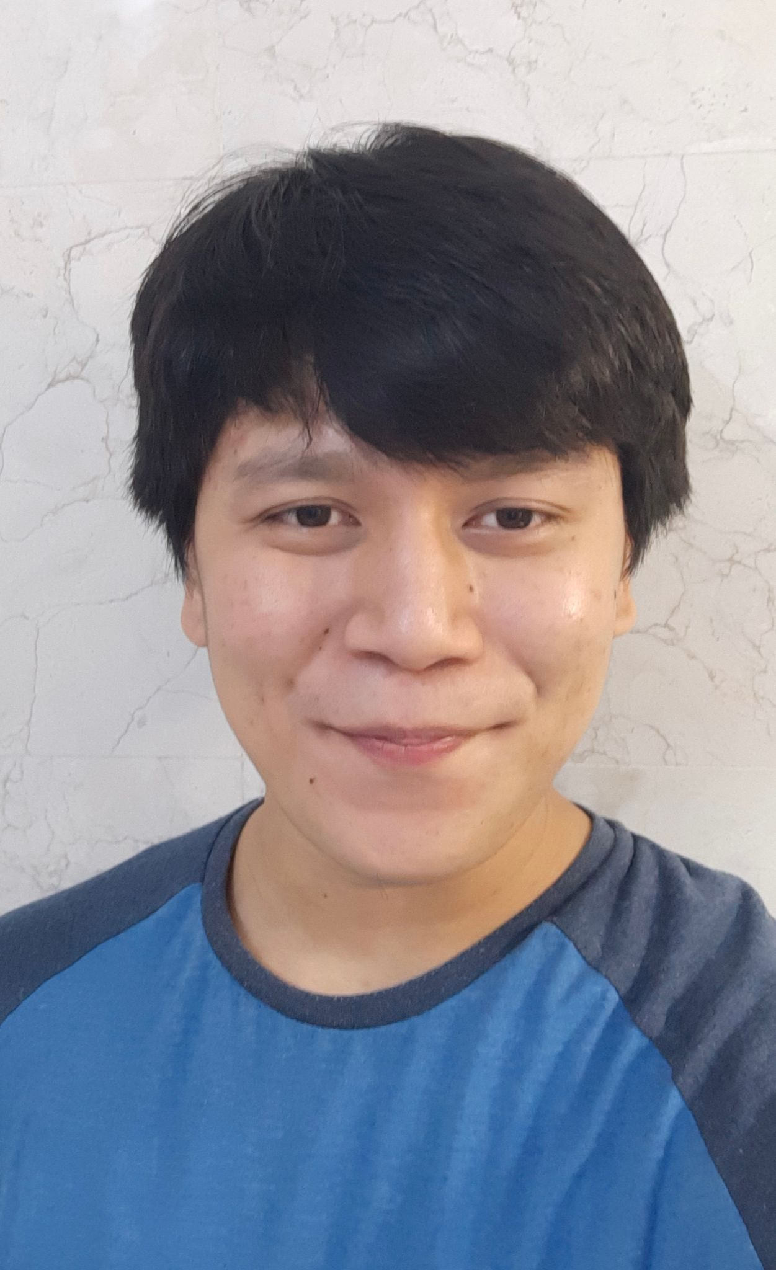
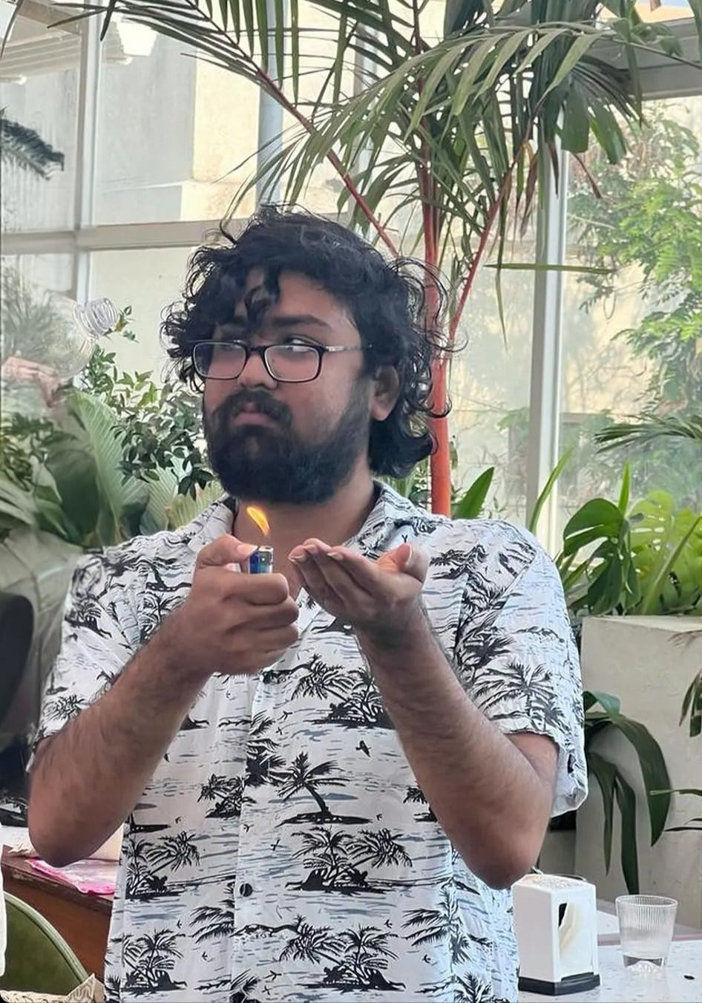
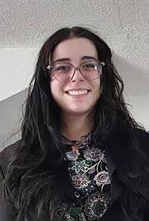
Team Members
Kris
Gurung
Anirudhhan
Raghuraman
Madalyn
Wiley

Slide 3
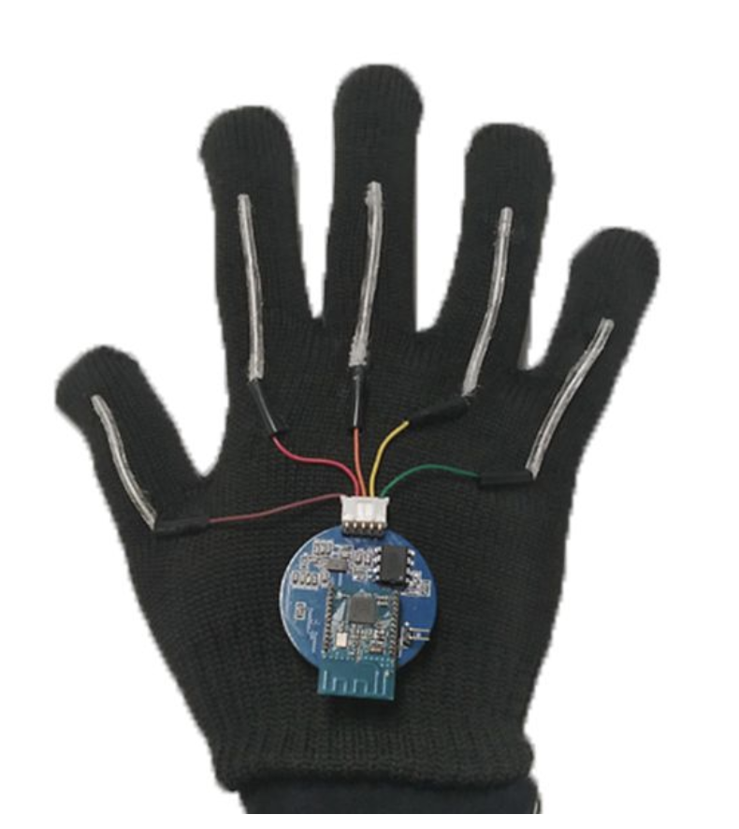
Project Description
Pair of American Sign Language (ASL) translating gloves.
Translation Goals:
ASL alphabets + Numbers
Static and Dynamic signs
Two synchronized gloves
Fig. 1: Glove by UCLA

Slide 4
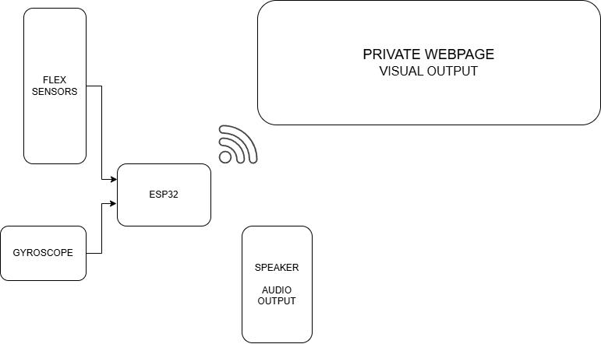
Project Description
Components:
Firebase Database
ESP32s
MPU6050s
Flex sensors
Gloves
Fig. 2: Flow Chart

Slide 5
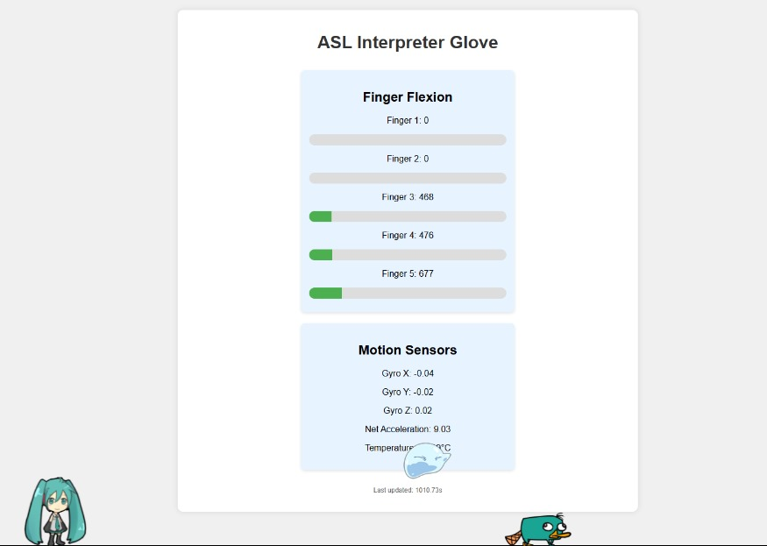
Progress
Configured ESP32 to read inputs:
From Flex sensors: Voltage values (determined by resistance due to ending the sensors)
From MPU6050: Gyroscope readings (X, Y, Z axis)
Integrated all components onto breadboard for testing (both hands)
Setup private server with ESP32 to host webpage to display input data.
Fig 3: Webpage

Slide 6
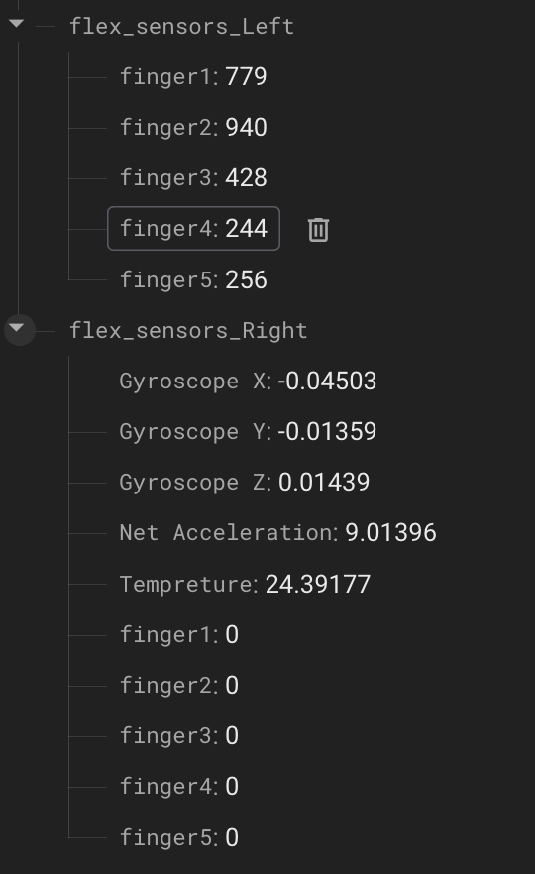
Progress
Configured ESP32 to read inputs:
From Flex sensors: Voltage values (determined by resistance due to ending the sensors)
From MPU6050: Gyroscope readings (X, Y, Z axis)
Setup Firebase server (live database for readings)
Configured ESP32 to transmit data to Firebase server (in real-time)
Saving data continuously to a CSV file.
Configuration for both hands: Left + Right Glove
Integrated all components on Breadboard for testing.
Fig 4: Realtime Database

Slide 7

Progress
Predictor model: Random Forest Decision Trees algorithm.
Reason for choosing model:
Handles non-linear relationships well
Resistant to overfitting due to randomization
Performs well even with moderate amount of data
Fig. 5: Graphical representation of RFDT

Slide 8
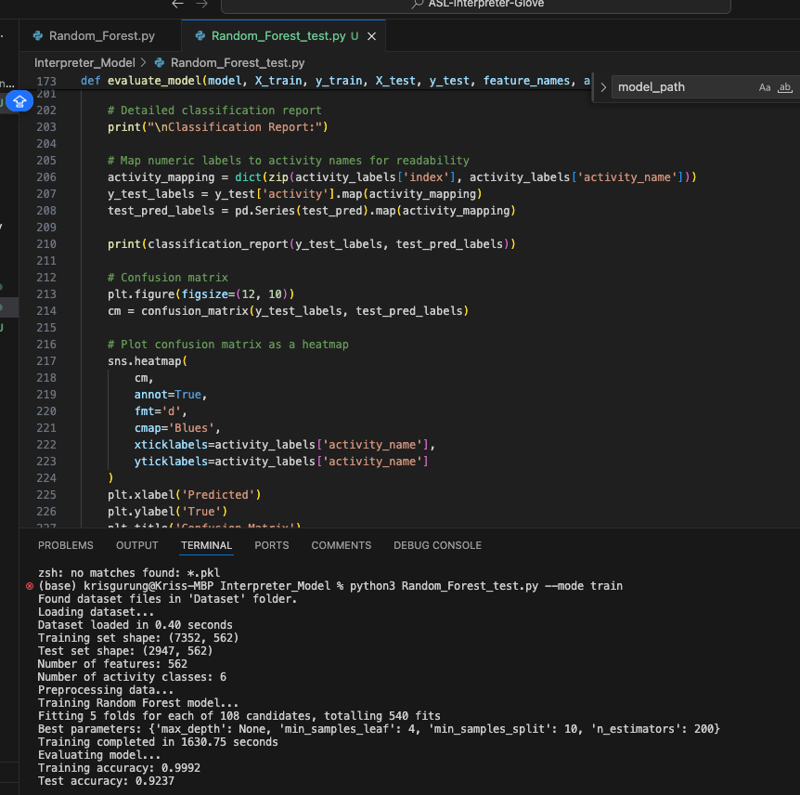
Progress
Random Forest model tested on similar dataset.
DATASET: Human Activity Recognition with Smartphones
TEST RESULTS:
Training Accuracy: 99.92%
Testing Accuracy: 95.37%
Fig. 6: RFDT Accuracy measure

Slide 9
Problems Posted
Q. How quickly will the user be able to sign without losing accuracy of translation?
Q. How will you be able to tell if the user is moving around the room versus moving their arm while signing?
Q. How do you plan on establishing communication between the two gloves?
Notes:
Q1. This depends on a variety of factors including Firebase speeds, prediction time, and ESP32 clockspeeds
Q2. The MPU6050, which we are using for the gyroscope, also has an accelerometer. The acceleration of a user moving around the room would be lower than if they were quickly changing arm position for a sign.
Q3. With the use of Firebase as the database that stores the sensor values, the ESP32s will not need to directly communicate with each other.

Slide 10
Next Steps
Permanently mount/attach equipment to glove
PCB Layout of circuit
Train predictor model to translate sensor readings to words
Synchronize two gloves

Slide 11
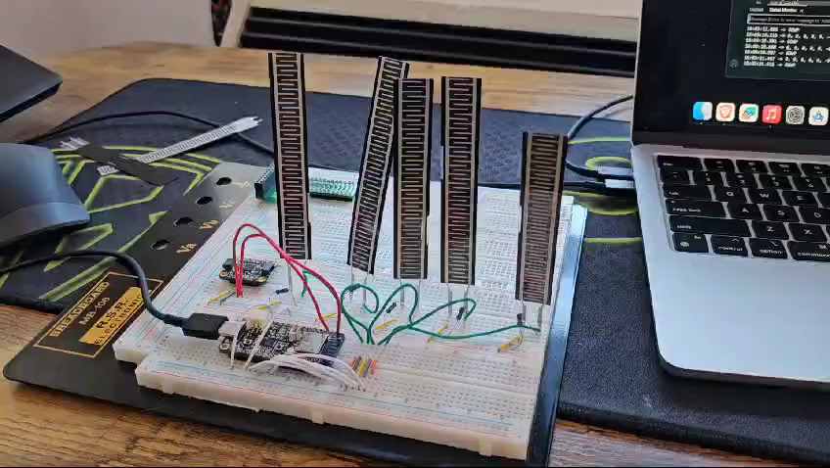
Demo

Slide 12
Roles
Kris:
Data Interpretation
Designing ML Models for interpretation
Model Testing
Ani:
Microcontroller Setup
Building the Web Server and Realtime Database
Communication Management
Madalyn:
System Integration
Circuit Design for the glove
Full System Testing.

Slide 13
THANK YOU
Q/A

